Slide 1



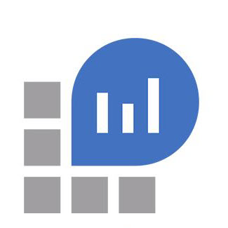

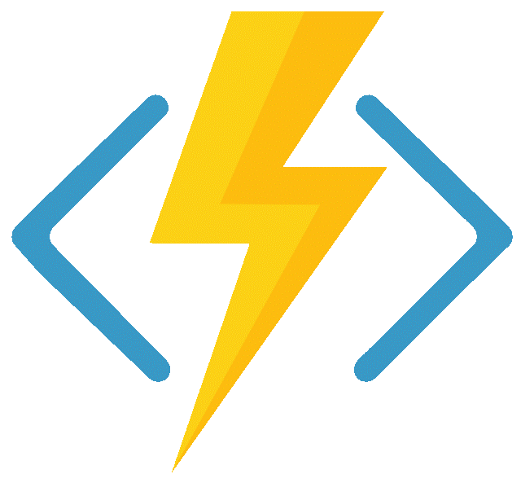
Application Insights and Azure Functions

Slide 2
Agenda
Examine
ILogger
Application Insight NuGet - TrackTrace, TraceEvent and TrackException
Log forwarding to Log Analytics

Slide 3
ILogger Questions
If a user logs information in code via the ILogger interface, what is logged and where is it logged?
If an exception bubbles out of the function call, what is logged and where is it logged?
When logging with scope, what does it look like in application insights?

Slide 4
ILogger answers
If a user logs information in code via the ILogger interface, what is logged and where is it logged?
trace only if the verbose, debug, information and warning messages
trace and exception for error and critical messages
If an exception bubbles out of the function call, what is logged and where is it logged?
trace only if the verbose, debug, information and warning messages
trace and exception for error and critical messages
When logging with scope, what does it look like in application insights?
??????????????

Slide 5
Application Insight NuGet package questions
Is it needed if you’re just using ILogger?
If the user uses TrackTrace, what is logged and where is it logged?
If the user uses TrackEvent, what is logged and where is it logged?
If the user uses TrackException, what is logged and where is it logged?

Slide 6
Application Insight NuGet package answers
Is it needed if you’re just using ILogger? No
If the user uses TrackTrace, what is logged and where is it logged? trace
If the user uses TrackEvent, what is logged and where is it logged? customEvents
If the user uses TrackException, what is logged and where is it logged? ?trace? and exceptions

Slide 7
Log Analytics workspace question
When all this data is forwarded to a Log Analytics workspace (preview), where does it go?

Slide 8
Log Analytics workspace answer
When all this data is forwarded to a Log Analytics workspace (preview), where does it go?
trace -> appTrace
exception -> appException
customEvents -> appCustomEvents

